Slide 1


Analysis of Monthly Energy Consumption by Customer Type and Zip Code in Nashville TN
By
Peter Busienei
Notes:
In this capstone ...
We define electricity intensity as electricity demand per person or dollar of economic activity. We argue that falling electricity intensity is driven largely by increased energy efficiency. Increases in efficiency across industrial, commercial and household sectors have arrested the growth in electricity consumption.

Slide 2

Facts
Nashville Electric Service(NES) is one of the 12 largest public electric utilities in the nation, distributing energy to more than 400,000 customers in Middle Tennessee.
NES has been in service for 80 years
NES is among only four percent of all public utilities in the country to receive the Reliable Public Power Providers Diamond Award, the industry’s highest honor for offering safe and reliable electricity to customers.
Average price of electricity: 10.65 ¢/kWh
Average monthly usage: 1,238 kWh per customer (2nd highest in the nation)
Average monthly bill: $129 (7th highest)
Notes:
1922 - Nashville's street car company merges into a new entity called the Tennessee Electric Power Co. (TEPCO).
1938 - TEPCO sues the Tennessee Valley Authority for trying to sell power in Nashville.
1939 - TVA wins the lawsuit and buys TEPCO for $79 million. Five-hundred employees of TEPCO become employees of the newly created Nashville Electric Service.
1950 - Construction begins on NES' headquarters at Church Street and 13th Avenue.

Slide 3
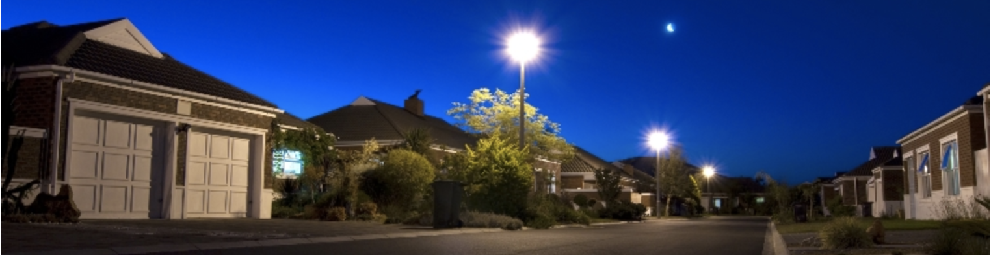
Nashville electric service(NES) customers
Residential: services for individual homes on permanent foundations, that are not part of a park.
Commercial: services to permanent commercial or industrial structures, outbuildings on residential property (barns, shops, pump-houses, garages, etc.), or any three-phase service whether it is for residential or commercial use.
Outdoor Lighting: services for outdoor security lighting to create a safer environment for homes or business. Lights can be installed on existing utility poles or on specially placed poles based on the necessary level of lighting.
Seasonal: Services offered during holidays such as Christmas tree stands, Christmas lights in Lebanon
Notes:
NES will visit your property to design a lighting plan tailored to your needs

Slide 4
Agenda
Classify consumers to different types
Analyze trends and total annual electric consumption
Analyze average annual energy consumption
Show average annual energy consumption per customer type
Show insights from the data for NES average energy consumption by zip code
The 10 highest and lowest energy consuming zip codes

Slide 5
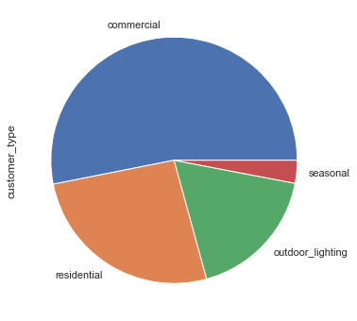
Who’s the highest consumer?
53.1%
3%
26.2%
17.7%

Slide 6
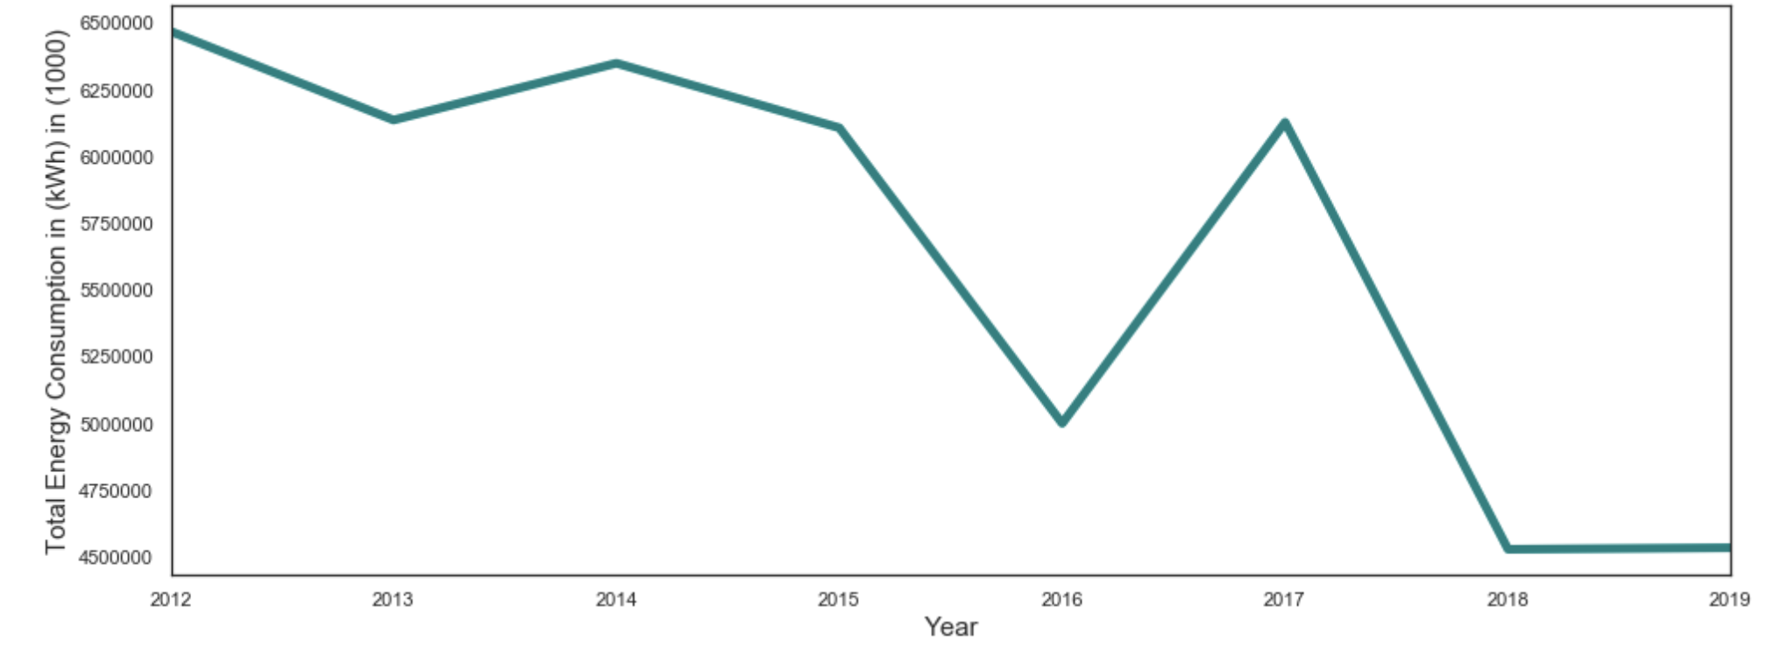
Total Energy consumption in Nashville city (2012-2019)
Notes:
Highest year being 2012, there is a decline trend lowest in 2019 as per the updated dataset on December 20, 2019

Slide 7
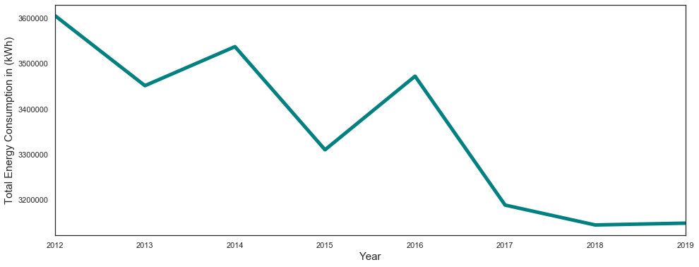
Avg annual energy consumption in (kWh)
Notes:
Decline in average energy consumption

Slide 8
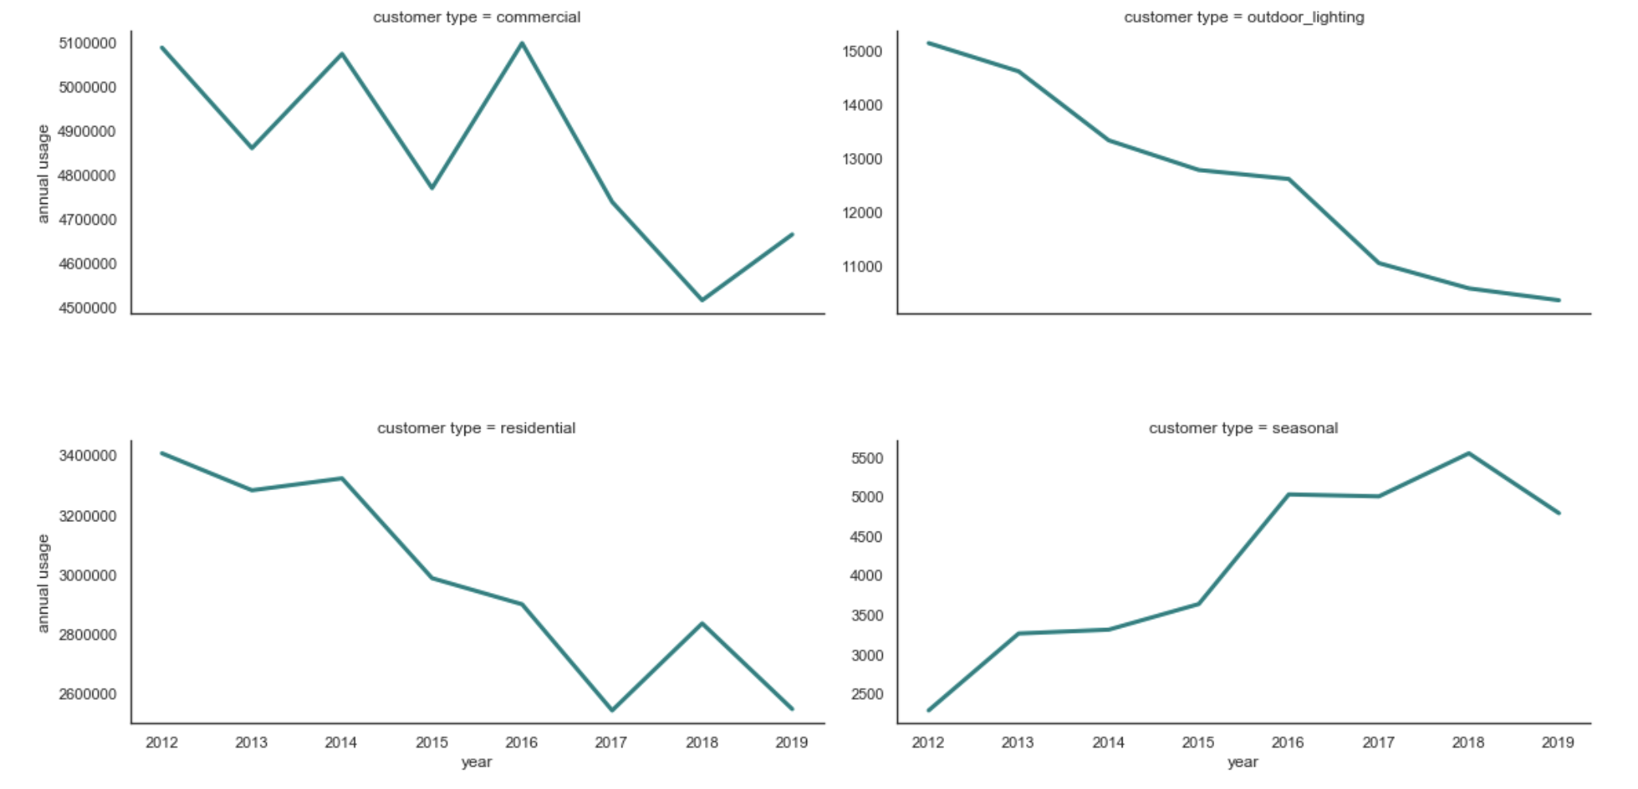
Avg annual energy consumption by customer type

Slide 9
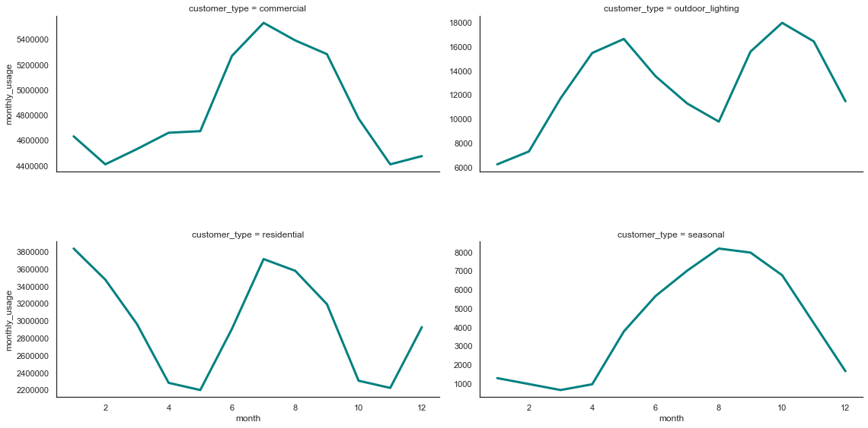
Avg monthly energy consumption by customer type

Slide 10
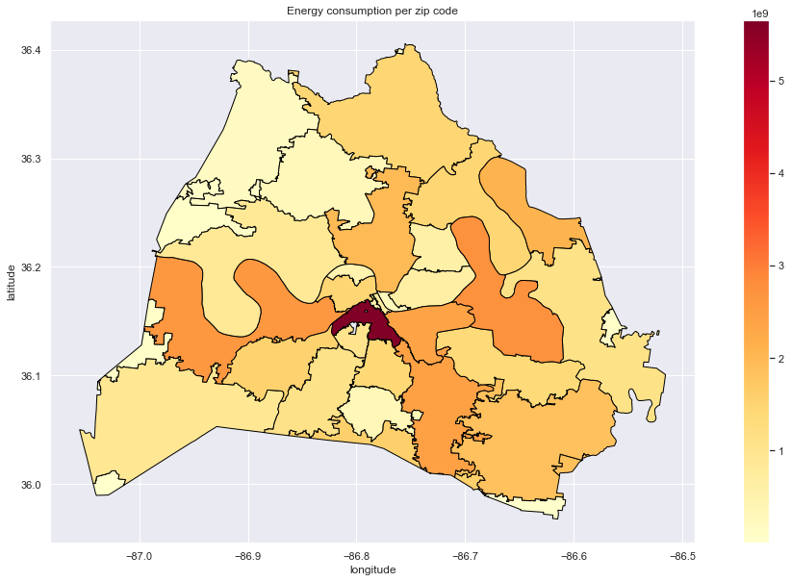
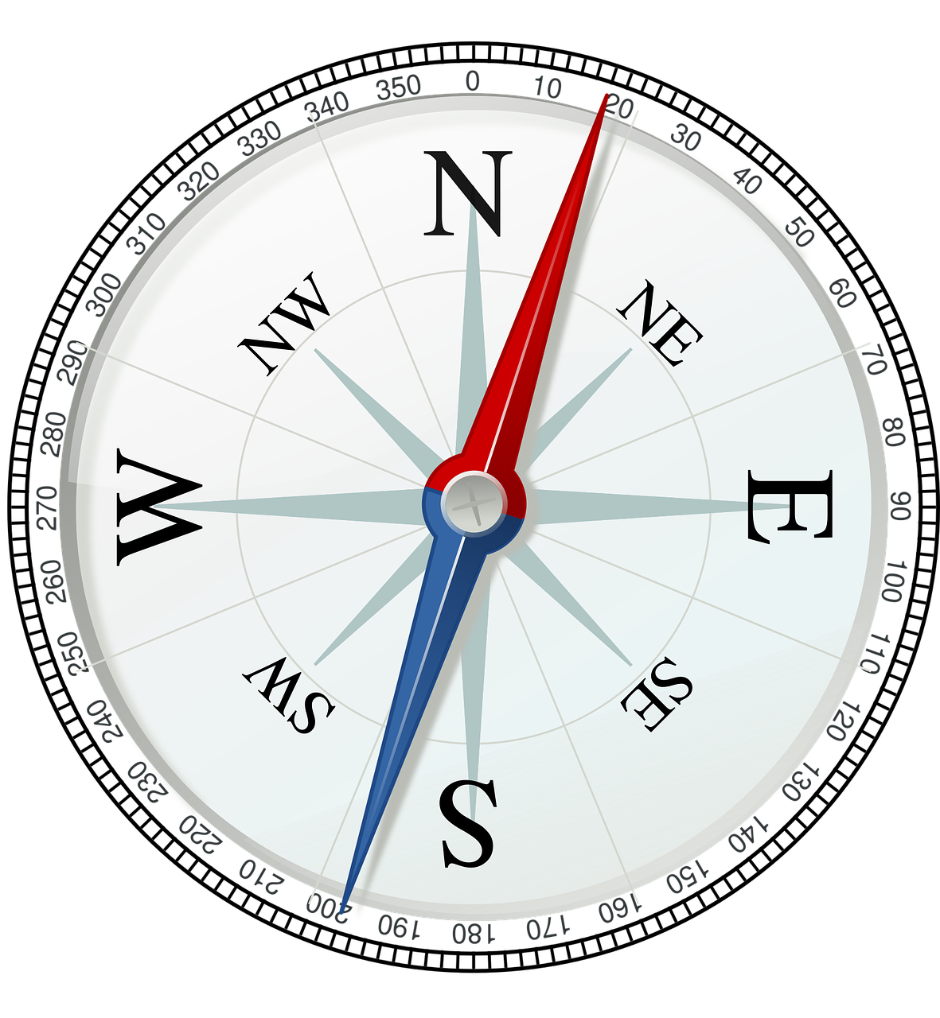
Total energy consumption per zip code
NSS
Notes:
What’s happening in 37203?

Slide 11
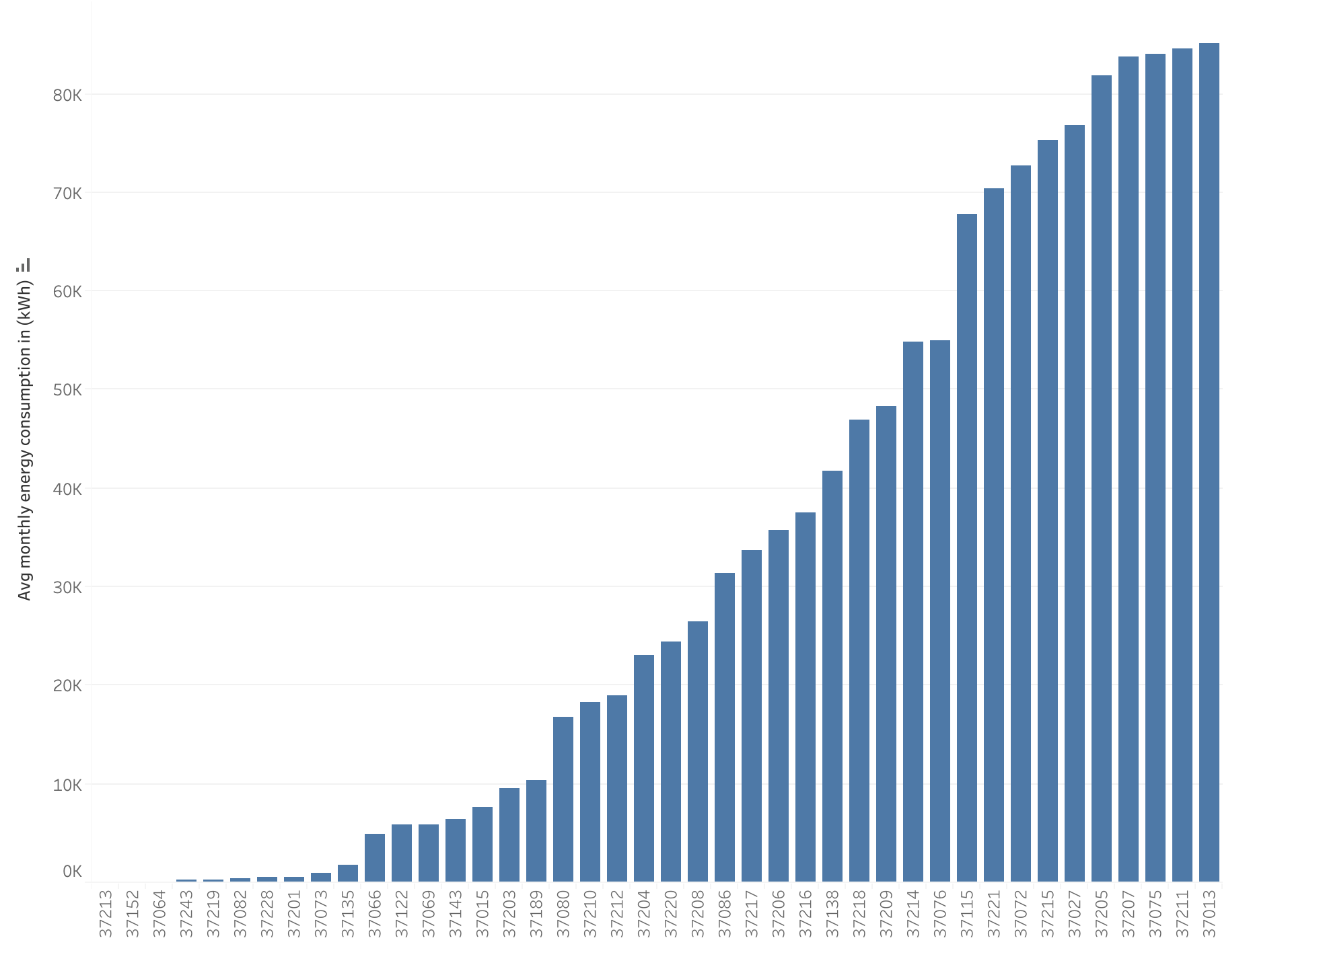
Avg monthly energy consumption per zip code
Zip code
Notes:
Average annual electricity consumption for a U.S. residential utility customer was 10,972 kilowatthours (kWh), an average of about 914 kWh per month. Tennessee had the highest annual electricity consumption at 15,394 kWh per residential customer as per U.S. Energy information administration.

Slide 12
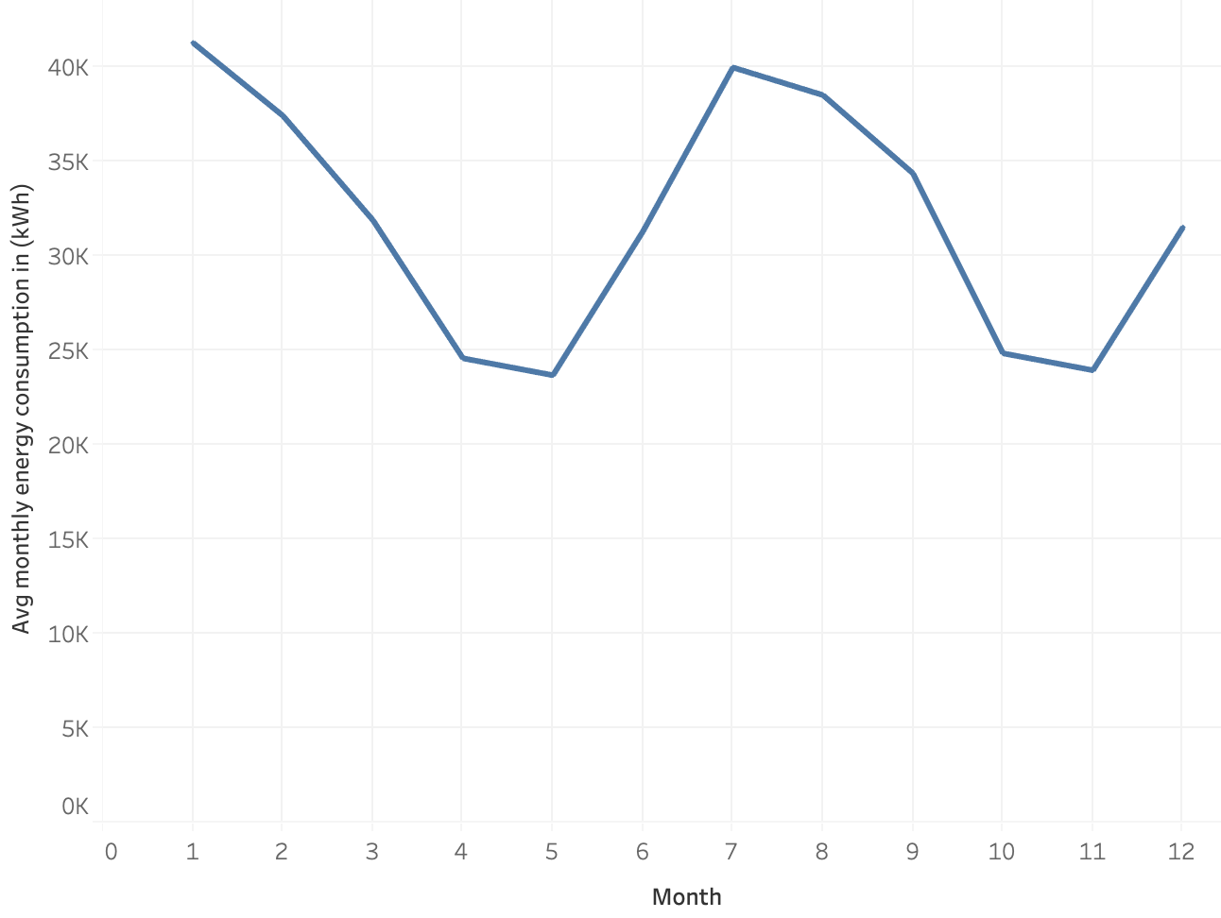
Residential energy consumption per month

Slide 13
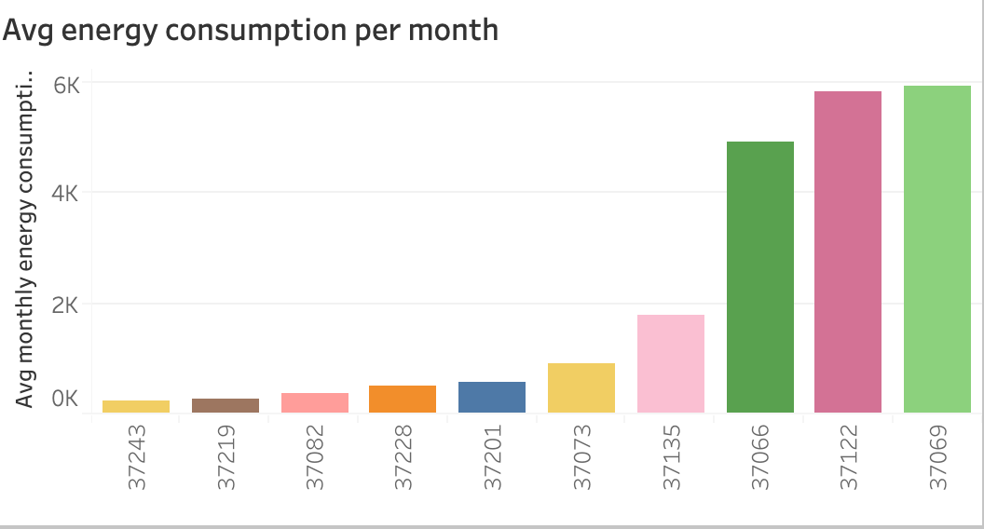
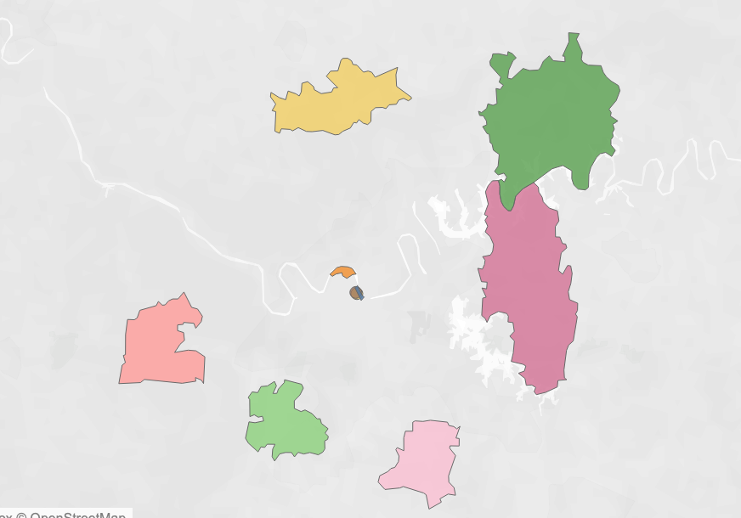
Lowest energy consuming zip codes

Slide 14
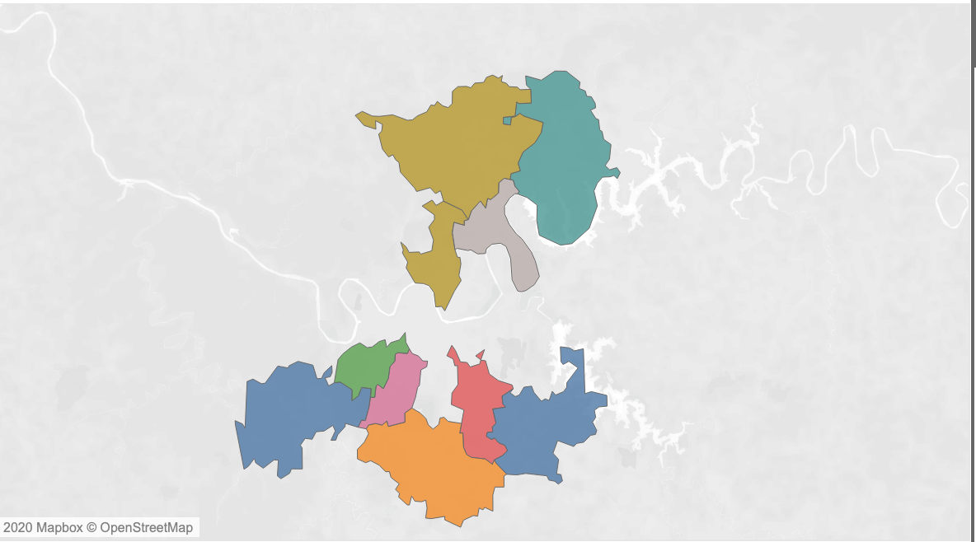
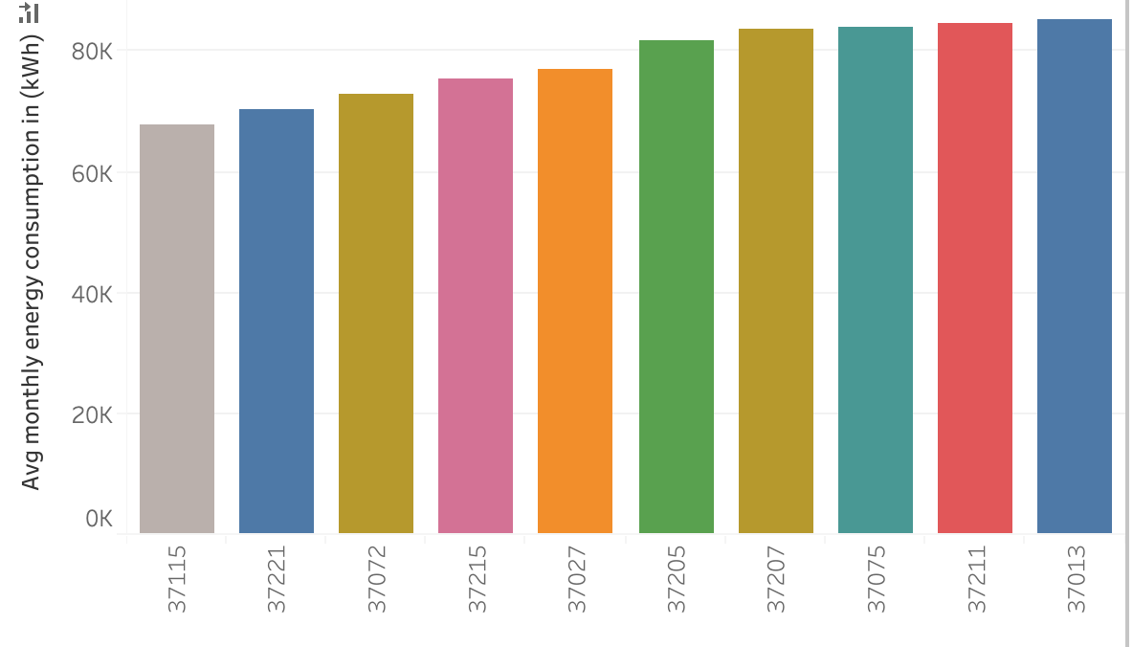
Top 10 energy consuming zip codes

Slide 15
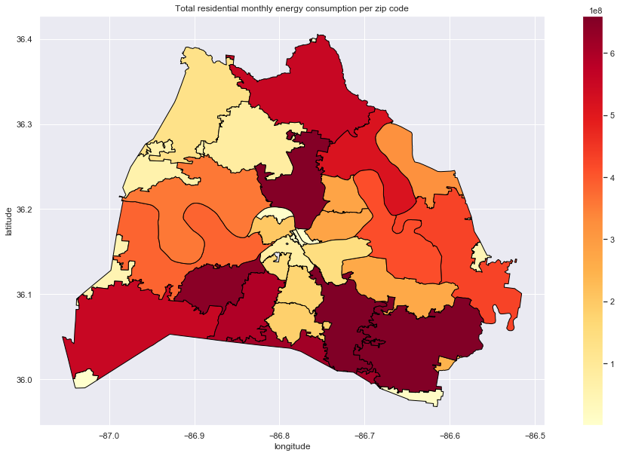
Where is more energy consumed?

Slide 16
References
Data.Nashville.gov (https://data.nashville.gov/Energy-Usage/NES-Monthly-Energy-Consumption-by-Customer-Type-an/vbx7-mn5i)
U.S. Energy Information administration( https://www.eia.gov/)
United States zip codes(https://www.unitedstateszipcodes.org/)
Choose energy (https://www.chooseenergy.com/news/article/the-states-that-use-the-most-and-least-amount-of-energy-per-household/)
Statistica (https://www.statista.com/statistics/807951/average-monthly-electricity-usage-in-major-us-cities/)
Nashville Electric Service https://www.nespower.com

Slide 17
Thank You!

Slide 18
Tableau Viz
https://public.tableau.com/profile/bush1897#!/vizhome/EnergyConsumption_15781937576950/Mydashboard?publish=yes

Slide 19
Appendix

Slide 20
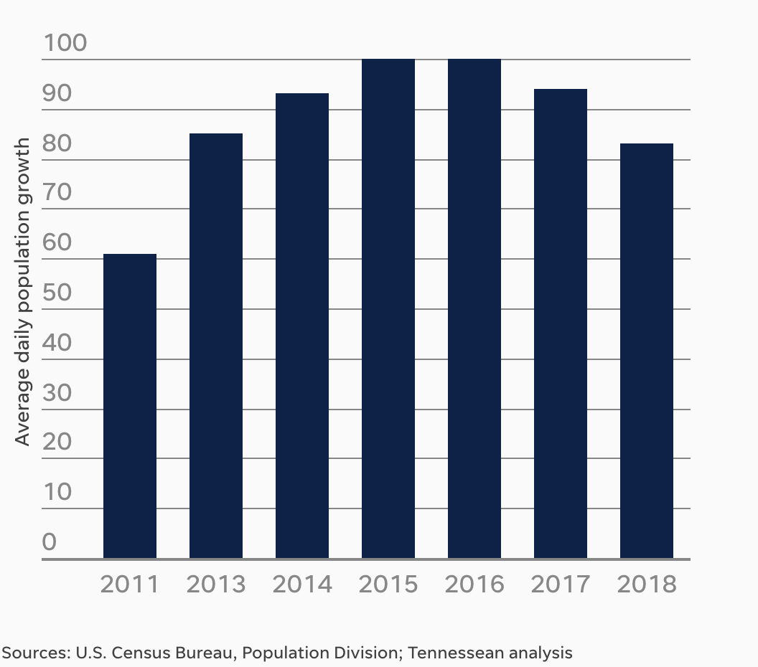
Nashville daily avg population growth

Slide 21
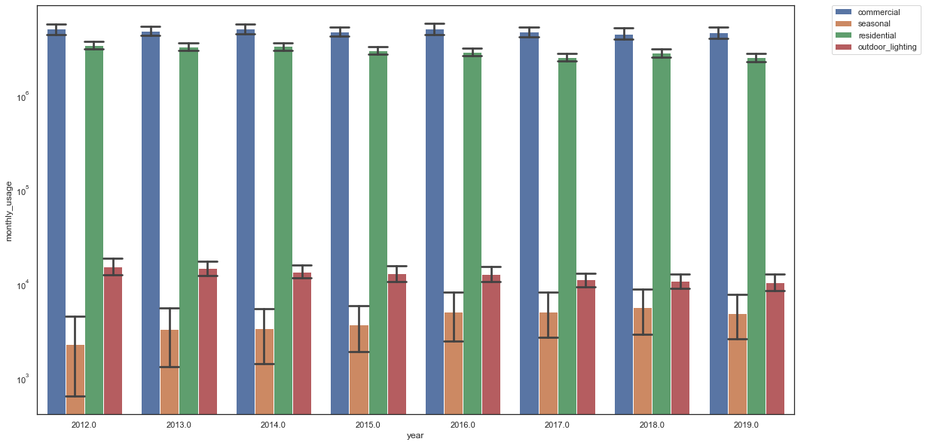
Energy consumption trends over the years
Notes:
SD error bars

Slide 22
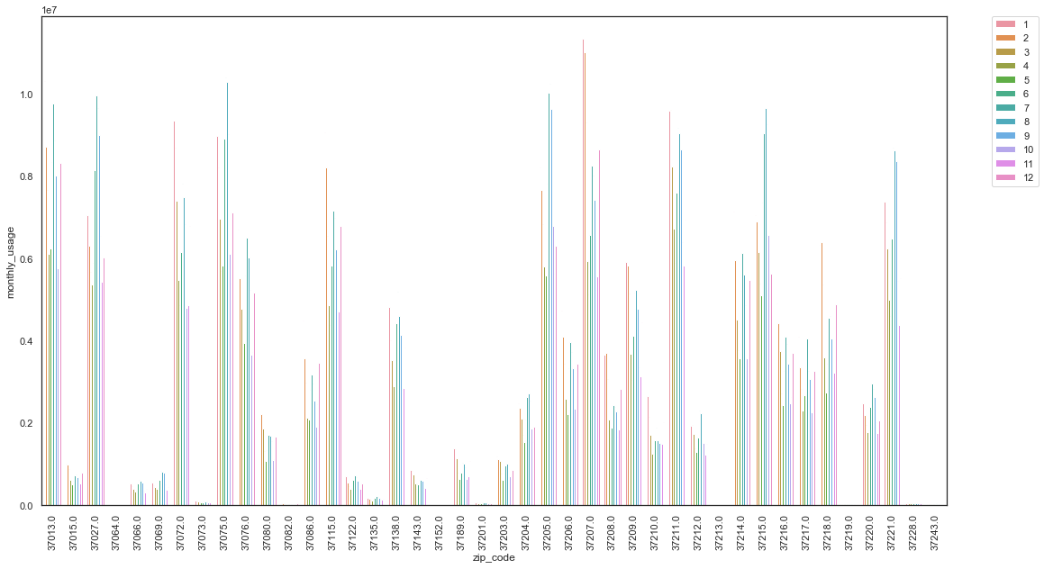
Residential monthly energy consumption
Notes:
Line plot could be better
Annual avg of each zip code

Slide 23
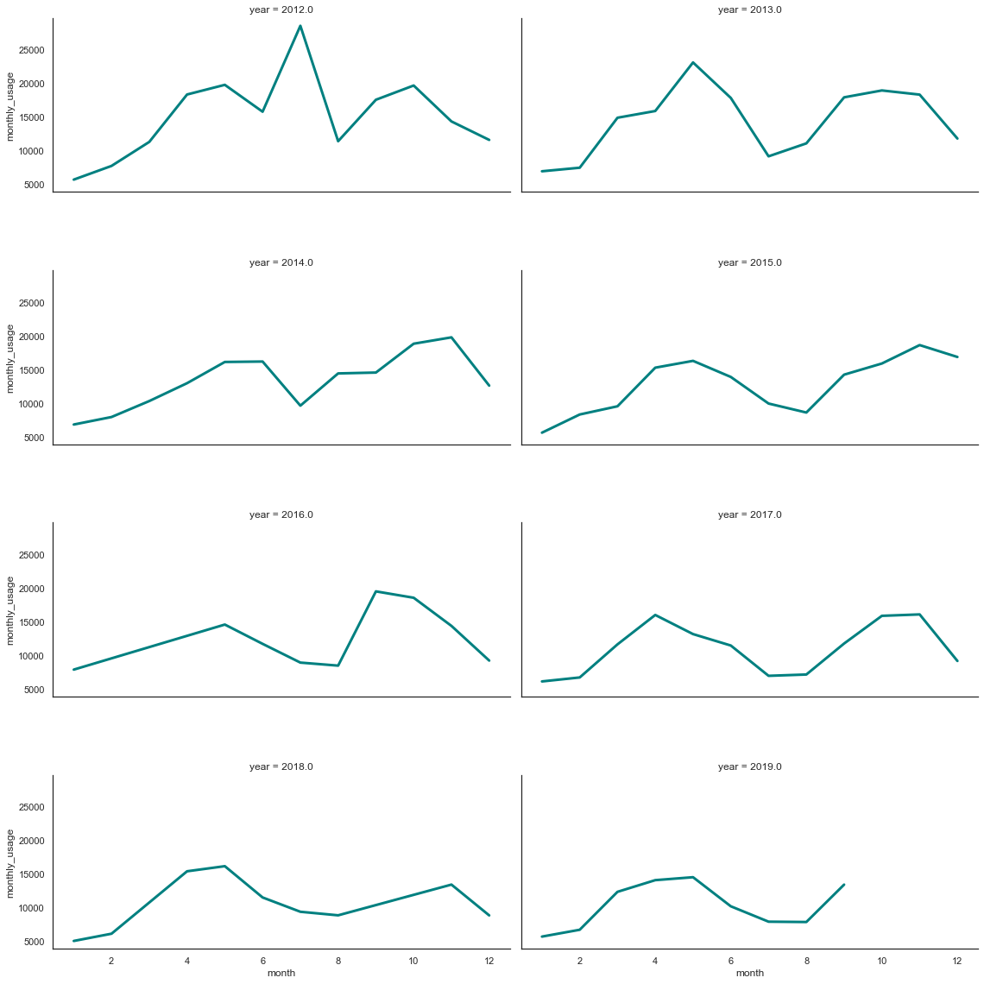
Monthly energy consumption per year ermonth

Slide 24
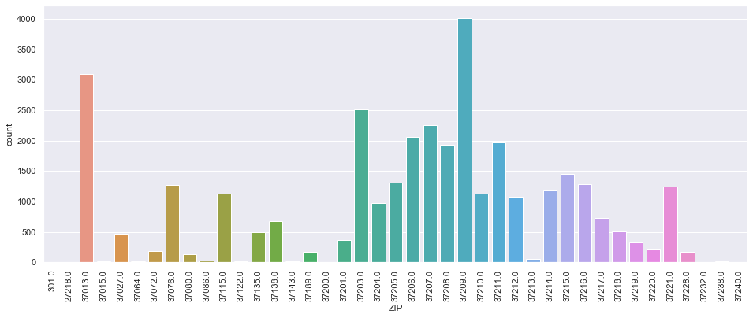
Total building permits issued
Notes:
Permits issued between 2015

Slide 25
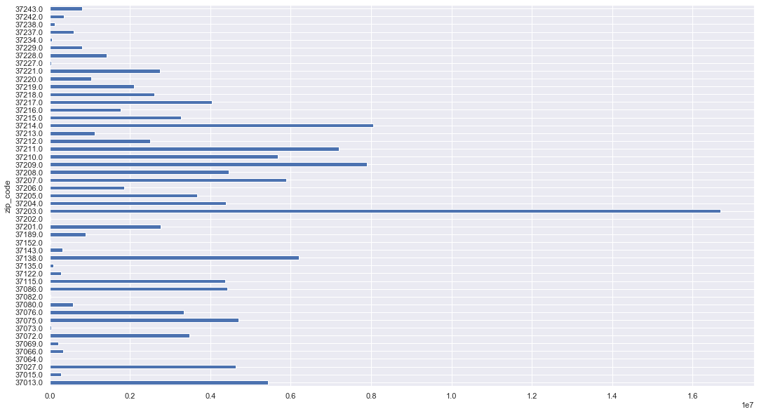
Total energy consumption per zip code

Slide 26
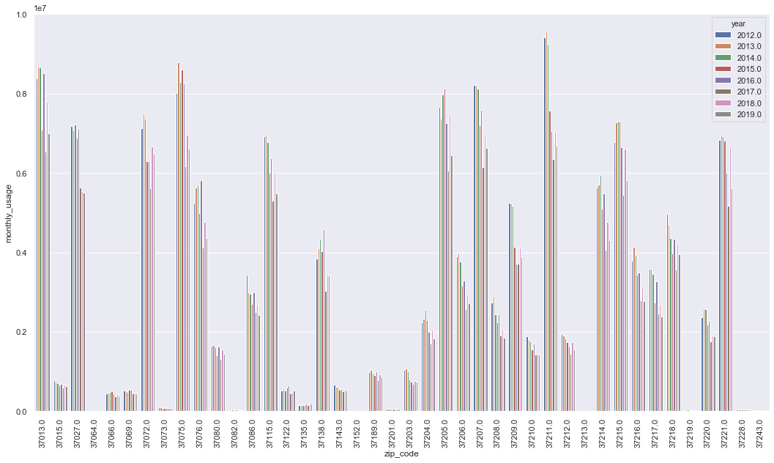
Residential annual energy consumption per zip code
Notes:
2012/2018 comparison graph
Average annual electricity consumption for a U.S. residential utility customer was 10,972 kilowatthours (kWh), an average of about 914 kWh per month. Tennessee had the highest annual electricity consumption at 15,394 kWh per residential customer as per U.S. Energy information administration.

Slide 27
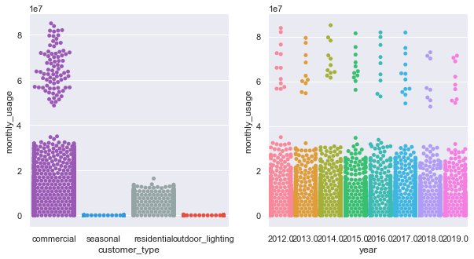

Slide 28
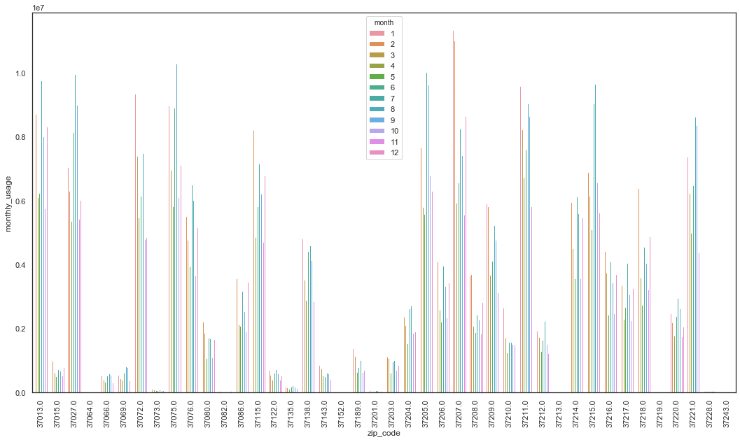
residential

